Slide 1
Brute Force Attack Using Hydra
By: Mohammed Odeh

Slide 2
What is hydra
The open-source login cracker Hydra allows us to use wordlists for many kinds of brute force and dictionary attacks. Hydra is commonly compatible with SSH (Secure Shell), FTP (File Transfer Protocol), and HTTP (Hypertext Transfer Protocol).
Attack
If you want specifics this can also be known as a dictionary attack, which is when we provide Hydra a list of passwords along with one or more usernames. Hydra then compares each of these passwords to each user on the list.

Slide 3
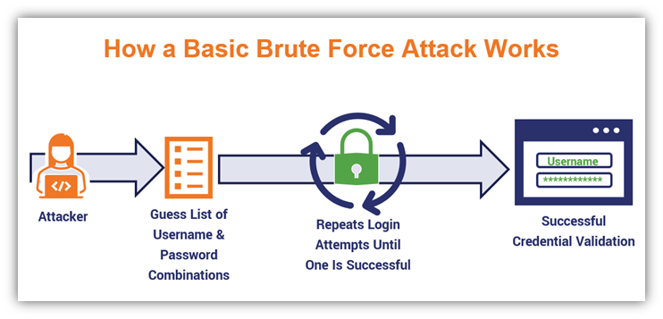
Visualization
Notes:
In this picture you can see the attacker trying to gain access into the server by guessing login credentials they have obtained until they successfully login with the correct credentials.

Slide 4
Research and Demo steps
Run the docker container by running the following command cd ./Documents/web-vulns && docker-compose up
Configured foxyproxy on burpsuite by confirming the interface is set to 127.0.0.1:8080 to listen for the web traffic
Installed proxy on firefox to send the web traffic to burpsuite by configuring the proxy type: HTTP, IP address:127.0.0.1,port 8080
Enabled the foxyproxy icon and typed in any login credentials
Viewed the captured traffic in burpsuite by clicking intercept on
Created a users.txt file that contained a bunch of common users and created a passwords.txt file that contained passwords from rockyou.txt
Ran the following command; hydra -L users.txt -P passwords.txt 192.168.13.25 http-post-form “/login.php:username=^USER^&password=^PASS^&Login=Login:Login failed”
Gave the results of the correct login credentials and successfully logged into the web page
Notes:
Hydra -L: Load several logins from file
-P load several passwords from file

Slide 5
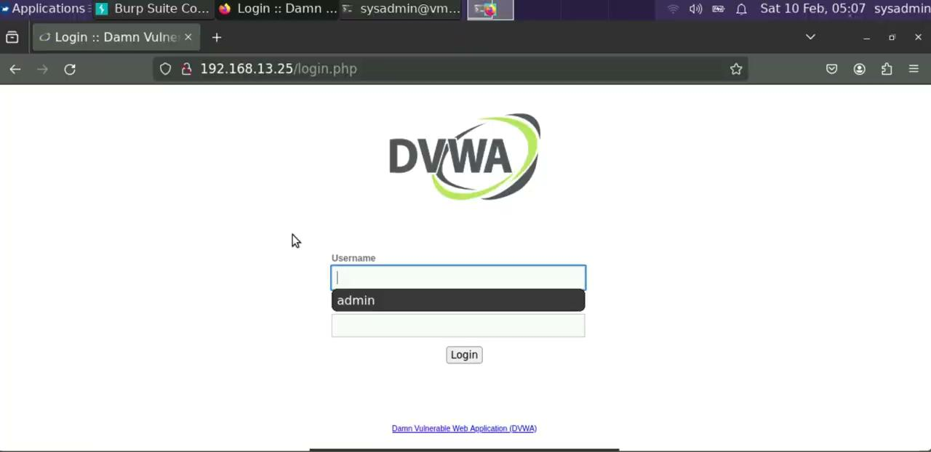
Demonstration

Slide 6
Impact
It could lead to data breaches which can lead to exposure of sensitive information, financial loss, and identity theft
Compromised accounts which the attacker has unauthorized access and can perform malicious activities
The attacker can cause service disruption by locking out authenticated users which results in a delay of the systems resources or unresponsive
It can impact the reputation of an organization which clients and customers lose trust in the organization by failing to protect the confidentiality of its customers

Slide 7
Mitigations
Strong Passwords: Encourage or require the use of complicated, strong passwords that are difficult to figure out
Account Lockout Policies: Put in place policies that, after a set amount of unsuccessful login attempts it temporarily locks out user accounts.
Monitoring: Keep an eye on any unusual login behavior and take appropriate action.
Salting and Hashing: Use unique salts and strong hashing to safeguard your passwords.
Awareness Training: Educate users about the best practices for password security.

